Slide 1



DAY 2
ADF&G R Intro Workshop

Slide 2
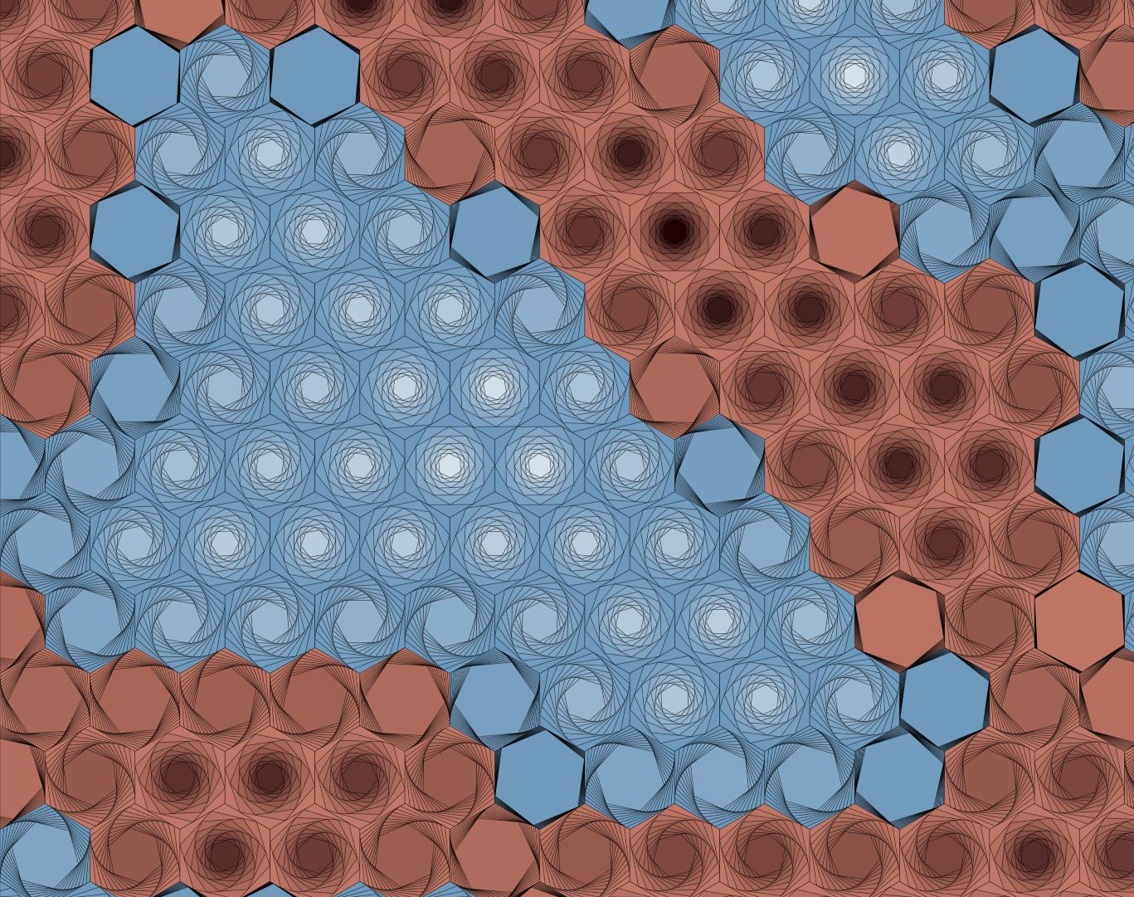
Welcome Back!
Yesterday was TOUGH, good work.
I want to reiterate how much progress you’ve already made!! It can be frustrating to learn a language, but keep at it.
What major things did you learn yesterday?
Let’s review some of the basics we covered
Generative a{R}t by Thomas Lin Pedersen
Notes:
It is normal to feel like you’re stretching your brain and or not advancing as fast as you wish. I felt like that, everyone I’ve talked to felt like that.
This is a language, and you can’t learn Russian or train for a marathon in one day, keep practicing.
That said, you’ve learned a LOT more than you knew yesterday morning

Slide 3
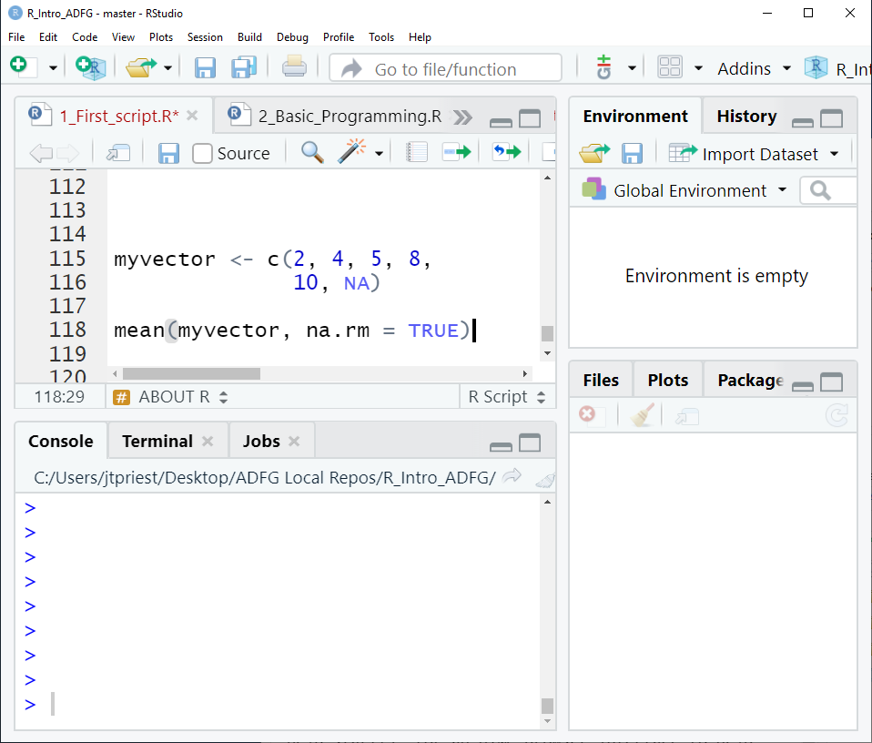
Review: General
A function has arguments
mean(dfname, na.rm = TRUE)
Use c() to concatenate items
Code lines must end in a comma, pipe, or be completed
function
data
argument

Slide 4
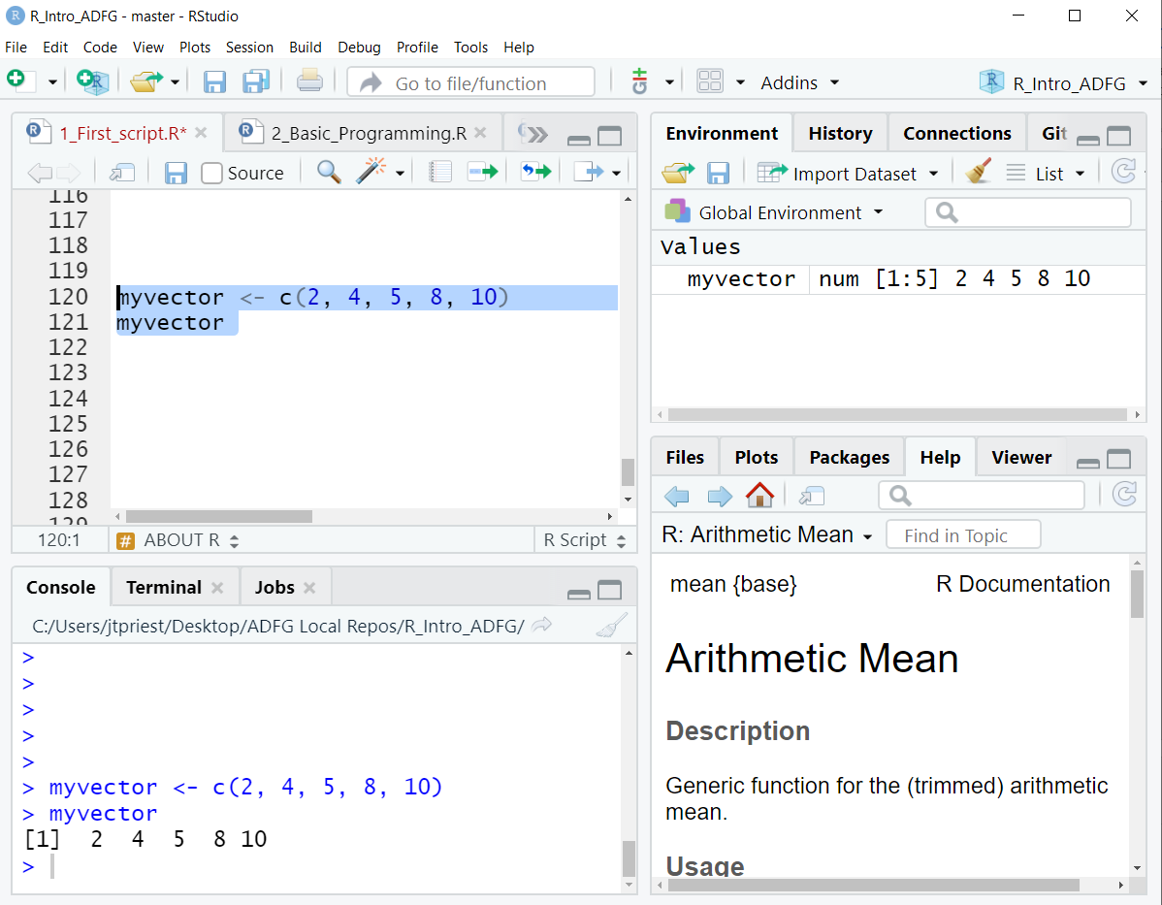
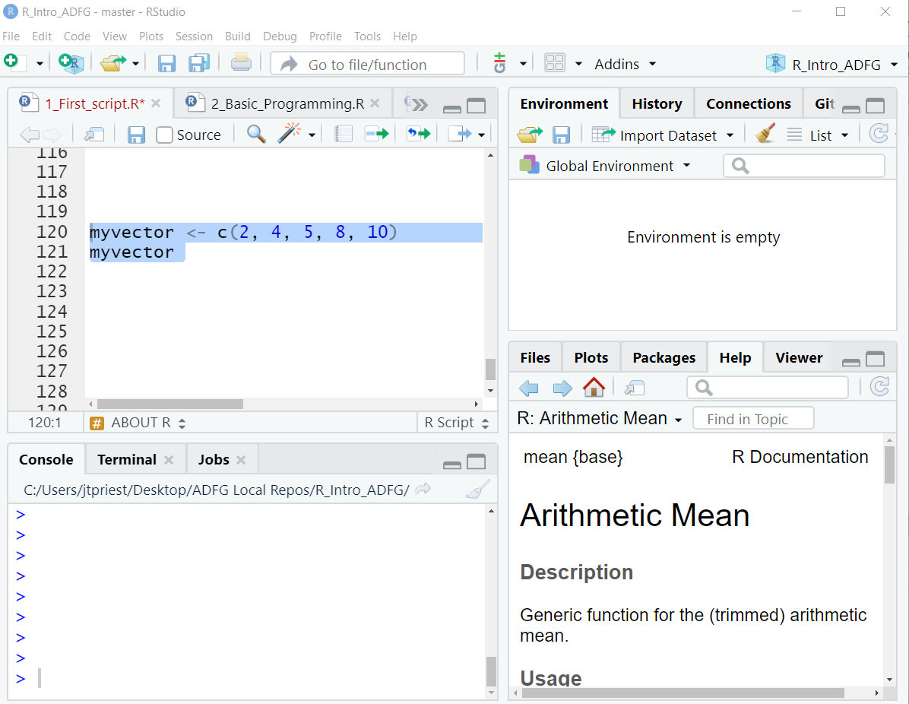
Review: General
Use “<-” to save a dataframe/vector
Otherwise code doesn’t save for access later (which is often fine!)
Ctrl + Enter (or Run Button) evaluates the line of code (sending it to console)
Put cursor somewhere in that line, or highlight the chunk you want
Objects in the environment disappear once we close R. We’ll need to re-run whole script to get them back. They don’t “live” anywhere permanently.

Slide 5
Review: Libraries
Run once!
A library is a new group of functions
The first time, use install.packages(“packagename”)
Every time you open a script use library(packagename) to load a library
If you see:
> install.packages(“dplyr”)
> library(dplyr)
Run every time you open R
> library(idonthavethispkgyet)
Error in library(idonthavethispkgyet) :
there is no package called ‘idonthavethispkgyet’
Notes:
Once you install a package once, you can just use the library function. Otherwise you’ll have to write install.packages()

Slide 6
Review: Data
Reading in Data
Use read_csv(“subfolder/filename.csv”)
Problems? Did you use correct:
Filename
Subfolder name
Are you in the correct directory?
Use str() to check the types
Use View() to inspect dataframe
Refer back to this when doing own project later today

Slide 7
Creating a New Project
Let’s go over how to do everything from scratch!

Slide 8
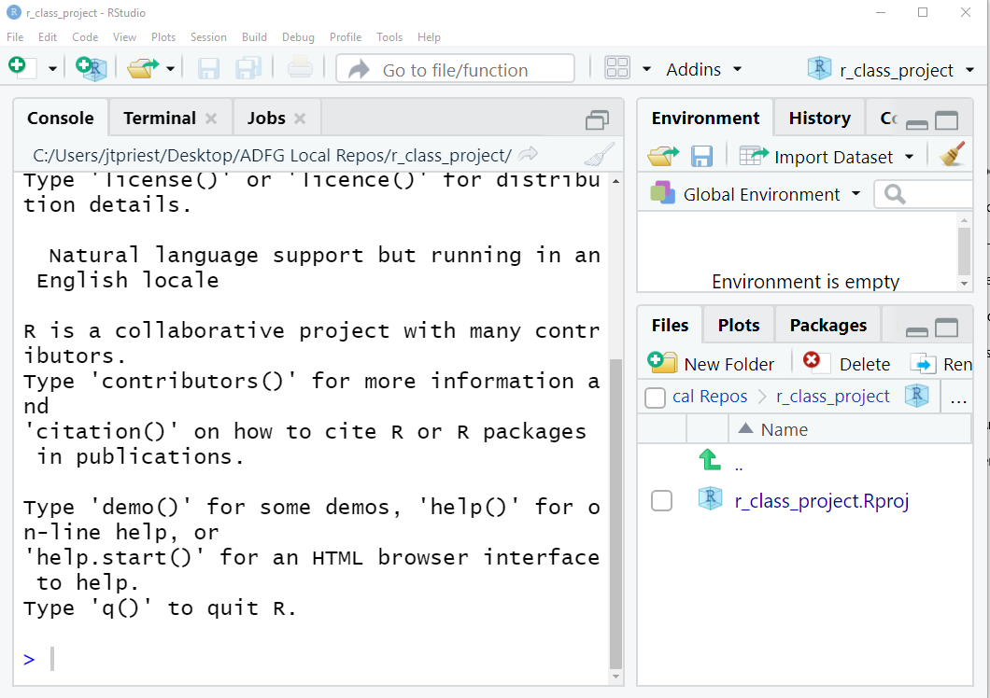
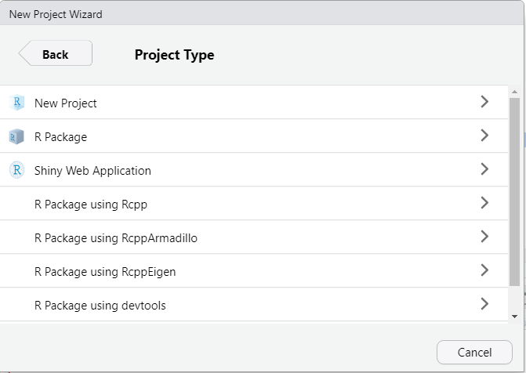
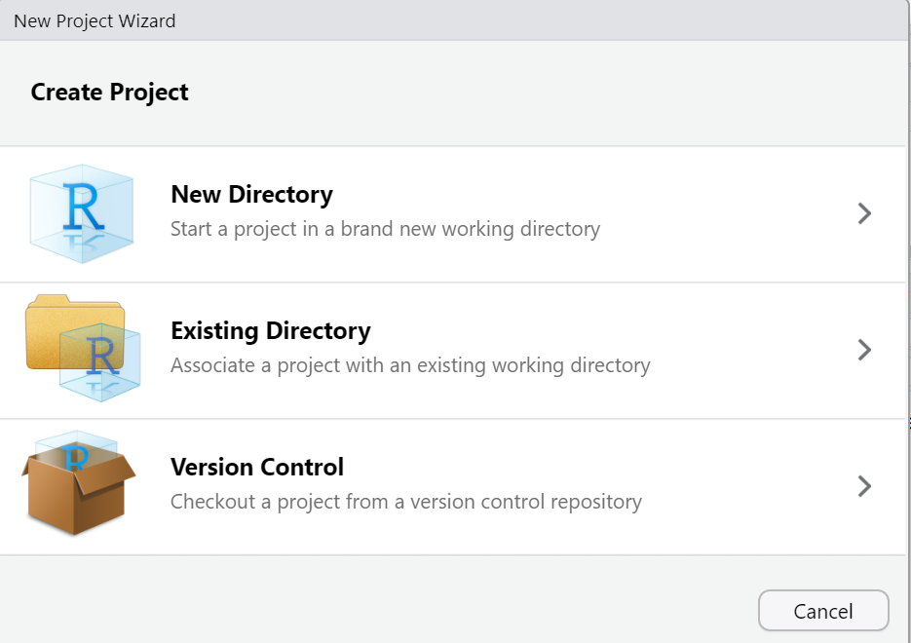
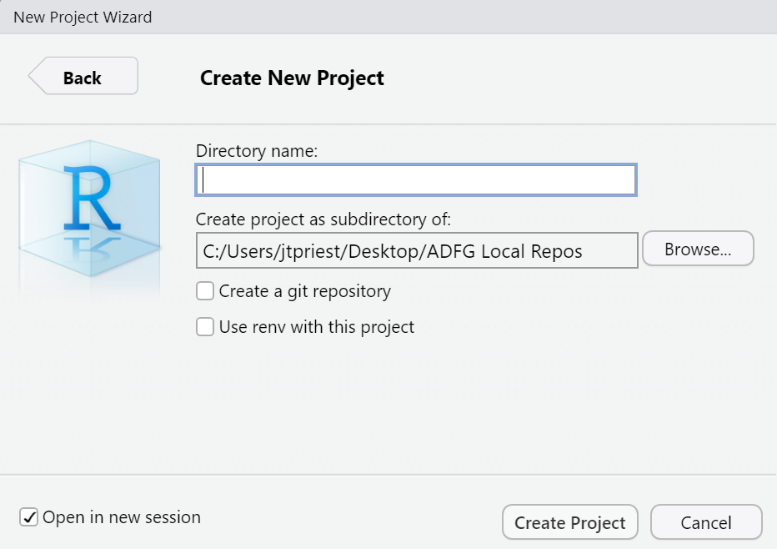
Create a Project
Open RStudio (any project or no project is fine)
File -> New Project
Do you want to create a folder?
Do you have an existing folder?
Choose New Project
Give it a memorable name (no spaces) and choose what folder you want it saved in
Success!
Notes:
I’ll go over how to start a New Di

Slide 9
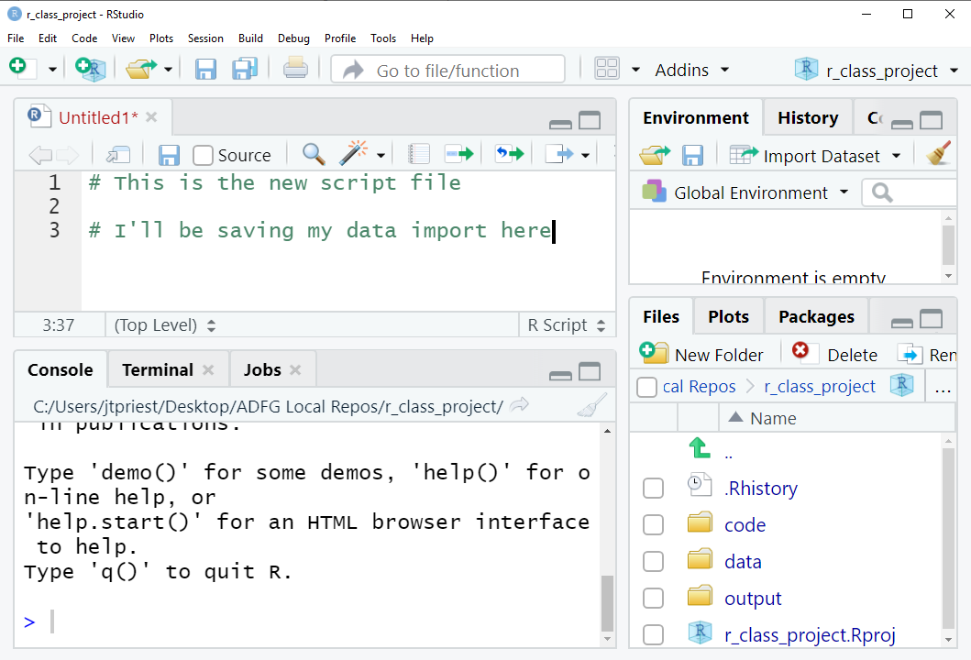
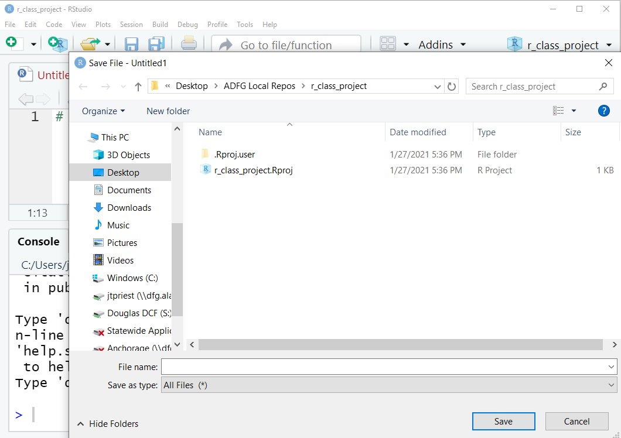
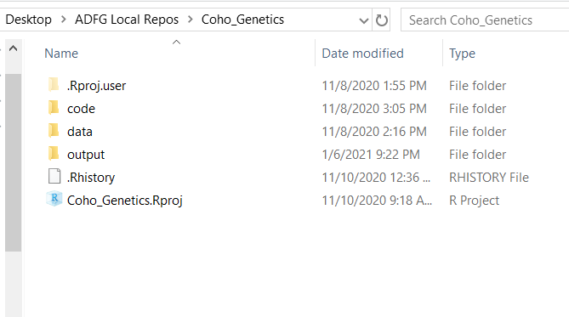
Create a Project, Part 2
File --> New File --> New R Script (Ctrl+Shift+N)
Write some code!
Save file but make a new folder called “code” first!
Open Windows Explorer folder. Create a folder named “data”, copy/paste some CSV files
Once completed, you should probably have something that looks like this

